Slide 1
Object Oriented Programming
Prof. Varsha Dange

Slide 2
Section 2 Lecture – 23
Prof. Varsha Dange

Slide 3
User-defined Custom Exception
Java provides us facility to create our own exceptions
which are basically derived classes of Exception.
For writing custom checked exception, extend Exception class.
Custom/user -defined exceptions in Java are those exceptions that are created by a programmer to meet the specific requirements of the application.
example:
1. A banking application, a customer whose age is lower than 18 years, the program throws a custom exception indicating “needs to open joint account”.
2. Voting age in India: If a person’s age entered is less than 18 years, the program throws “invalid age” as a custom exception

Slide 4
How to create User-defined Custom Exception
Step 1: User-defined exceptions can be created simply by extending Exception class.
class OwnException extends Exception
Step 2: If you do not want to store any exception details, define a default constructor in your own exception class.
OwnException () {
//body of constructor
}

Slide 5
How to create User-defined Custom Exception
Step 3: If you want to store exception details, define a parameterized constructor with string as a parameter, call superclass (Exception) constructor from this, and store variable “str”.
OwnException (String str){
super(str); }
Step 4: In the last step, we need to create an object of user-defined exception class and throw it using throw clause.
OwnException obj = new OwnException(“ExceptionDetails”);
throw obj; or throw new OwnException(“ExceptionDetails”);
Example

Slide 6
Chained Exception
Java 2, version 1.4 added a new feature chained exceptions.
The chained exceptions feature relates one exception with another exception.
The second exception explains the cause of the first exception.
Chained exception in Java is a technique to handle exceptions that occur one after another.
For example, let us assume that a, b, and c are objects of three different exception types A, B, and C respectively. The object a of type A causes an exception of type B to occur and an object of B type also causes an exception of C type.

Slide 7
Chained Exception
For example, consider a situation in which a method throws an ArithmeticException because of an attempt to divide by zero
but the actual cause of exception was an I/O error which caused the divisor to be zero.
The method will throw only ArithmeticException to the caller.
So the caller would not come to know about the actual cause of exception.
Chained Exception is used in such type of situations.

Slide 8
Constructors of Throwable class to support Chained Exceptions
from 1.4 ,The constructors that support chained exception in java are as follows:
1. Throwable(Throwable causeExc) // causeExc is exception that causes current exception. 2. Throwable(String msg, causeExc) // msg is an exception message and causeExc is exception that causes the current exception.

Slide 9
Methods of Throwable class to support Chained Exceptions
toString(): This method returns an exception followed by a description of the exception. The general syntax is as follows:
public String toString()
2. getMessage(): It returns the description of exception.
public String getMessage()
3. printStackTrace(): This method displays stack trace. It returns nothing. public void printStackTrace()

Slide 10
Methods of Throwable class to support Chained Exceptions
getCause(): This method returns actual cause of an exception. If there is no caused exception then null is returned.
public Throwable getCause()
5. initCause(): - using initCause() ,we are setting cause of exception.
The initCause() method joins “causeExc” with the invoking exception and returns a reference to the exception.
public Throwable initCause(Throwable causeExc)
Example

Slide 11
class TestEx{
public void div(int num1,int num2) {
try {
System.out.println(num1/num2);
}
catch(ArithmeticException ae) {
System.out.println("getMessage: "+ae.getMessage());
System.out.println("getCause: "+ae.getCause());
System.out.println("toString: "+ae.toString());
System.out.println("printStackTrace: ");
ae.printStackTrace());
}}
}
public class Test123 {
public static void main(String[] args) {
TestEx t =new TestEx();
t.div(4,0);
}
}

Slide 12
import java.io.*;
public class Test123 {
public static void main(String[] args) {
try {
ArithmeticException ae=new ArithmeticException("Exception");
ae.initCause(new IOException(" This is the actual cause of exception"));
throw ae;
}catch(ArithmeticException ae) {
System.out.println(ae);
System.out.println(ae.getCause());
}
}
}

Slide 13
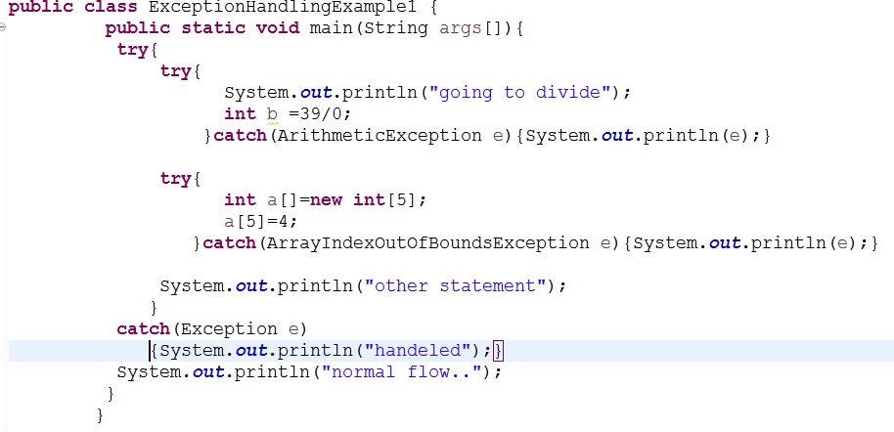
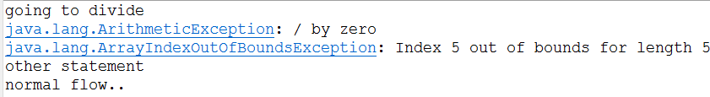
Nested try block
Output :

